Slide 1
IBM CAPSTONE PROJECT

Slide 2
CONTENTS
1
Introduction
2
Data Description
3
Methodology
4
Results
5
Discussion
6
Conclusion

Slide 3
RECOMMENDING BUSINESS VENTURES THAT ARE MOST LUCRATIVE AROUND A COLLEGE OR UNIVERSITY CAMPUS IN THE UNITED STATES
By Gospel Saloka-odenma

Slide 4

AIM
AIM
This work seeks to recommend lucrative businesses one could establish around a college or university campus in the United States.
Click here to add content of the text，and briefly explain your point of view

Slide 5


OBJECTIVES
What kind of businesses are located around a university campus
How do we know the most available businesses
How do we cluster them
What businesses can we recommend

Slide 6

Data of a few United States university campuses were obtained from data.world2 in geojson format. The dataset had the geographical coordinates of each campus nested within the geojson file. The geojson file was cleaned and formatted into a dataframe.
DATA
TITTLE
The Foursquare API3 was used to get the common venues around the universities within 1000 mile radius
Folium package was used to create maps and place markers on leaflet maps within each campus latitude and longitude location.

Slide 7
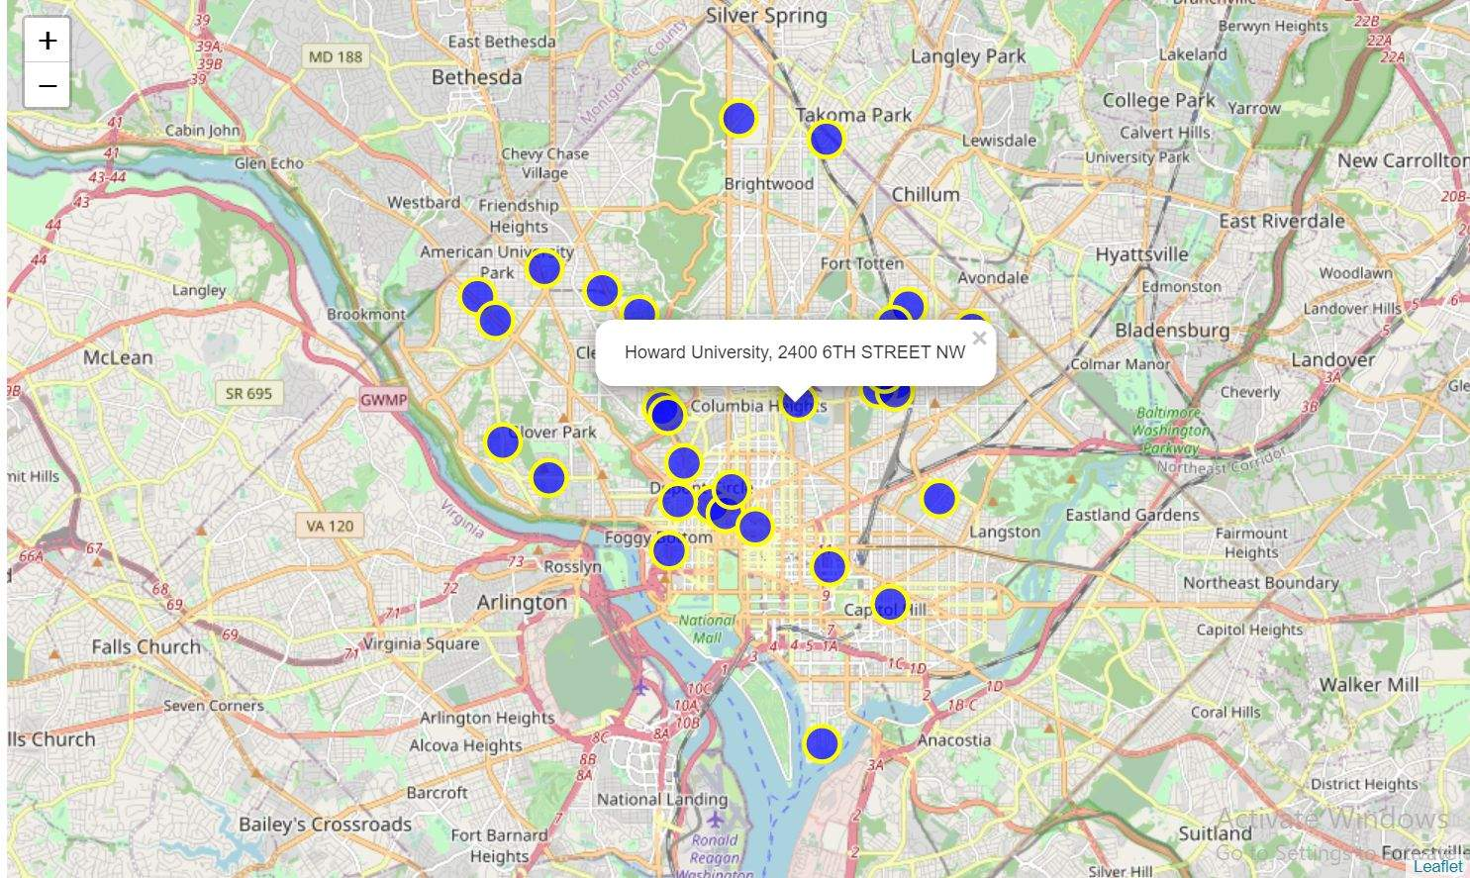
METHODOLOGY
Map of US colleges and university campuses with with markers supper imposed

Slide 8
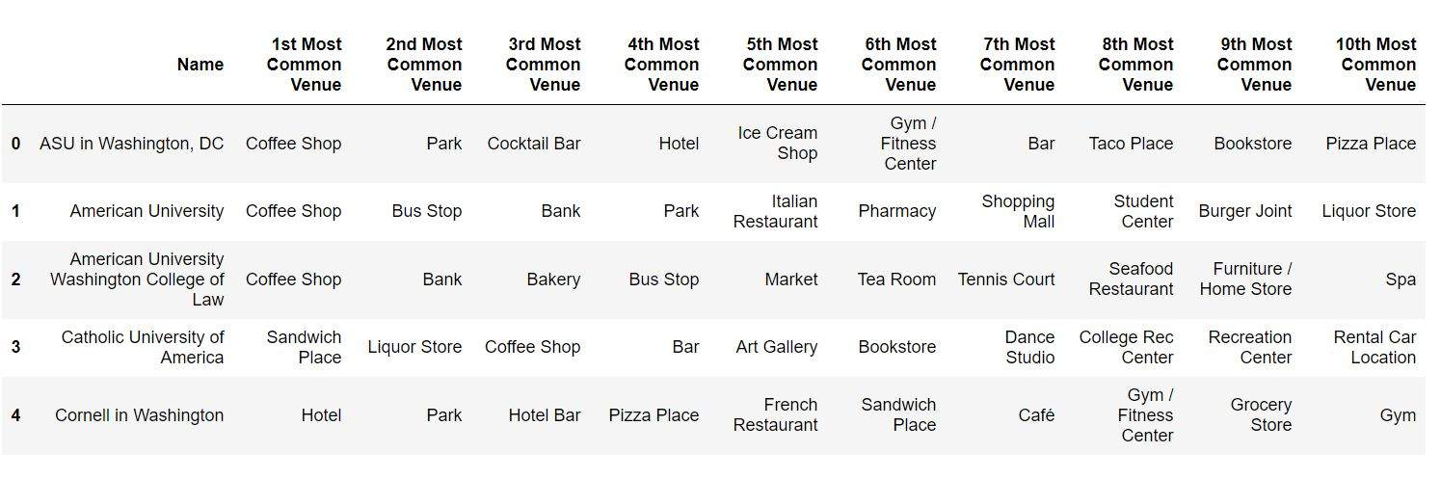
EXPLORING TOP 10 MOST COMMON VENUES AROUND EACH CAMPUS
Enter title here
Click here to add content of the text，and briefly explain your point of view

Slide 9
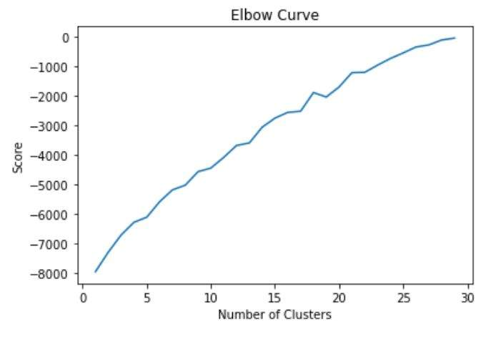
CLUSTERING NEARBY VENUES
The elbow suggests 5 clusters
Key words
Key words
22%
Key words
Key words
Key words
21%
Key words
Key words

Slide 10
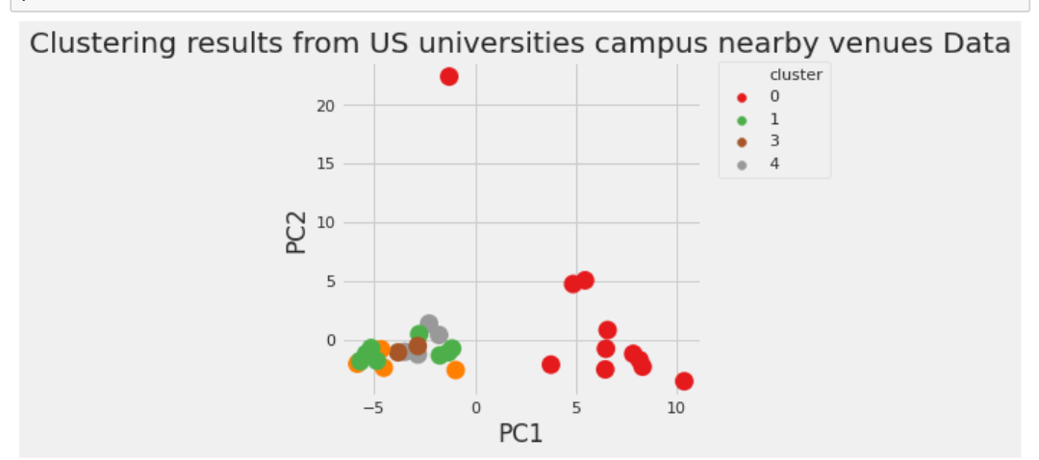
PRINCIPAL COMPONENTS ANALYSIS WITH TWO (2) COLLUMNS AND FIVE(5) CLUSTERS
scatter plot of the Principal Component Analysis

Slide 11
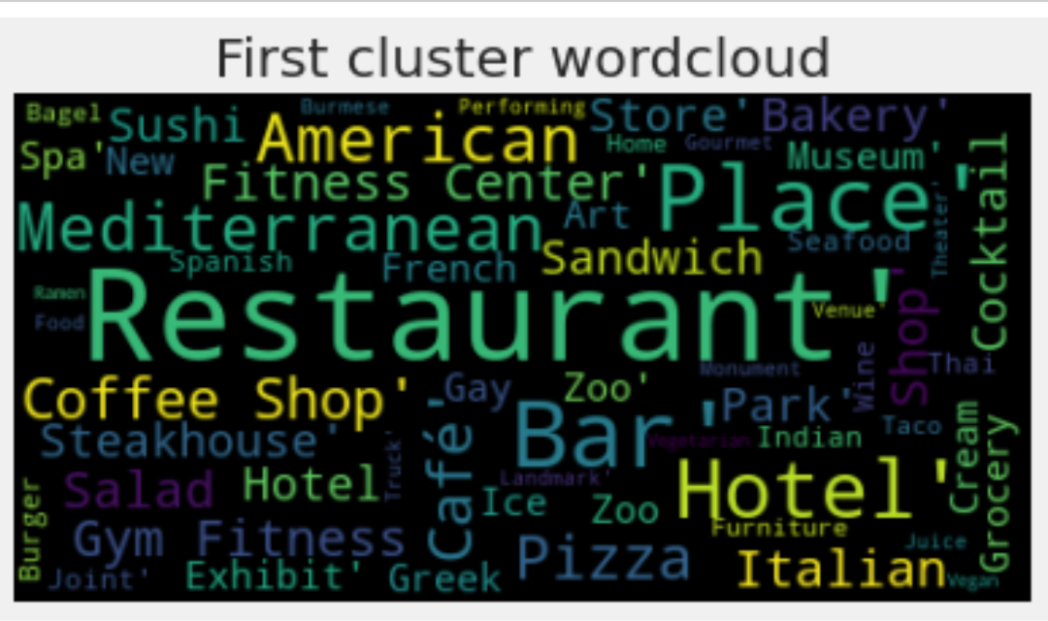
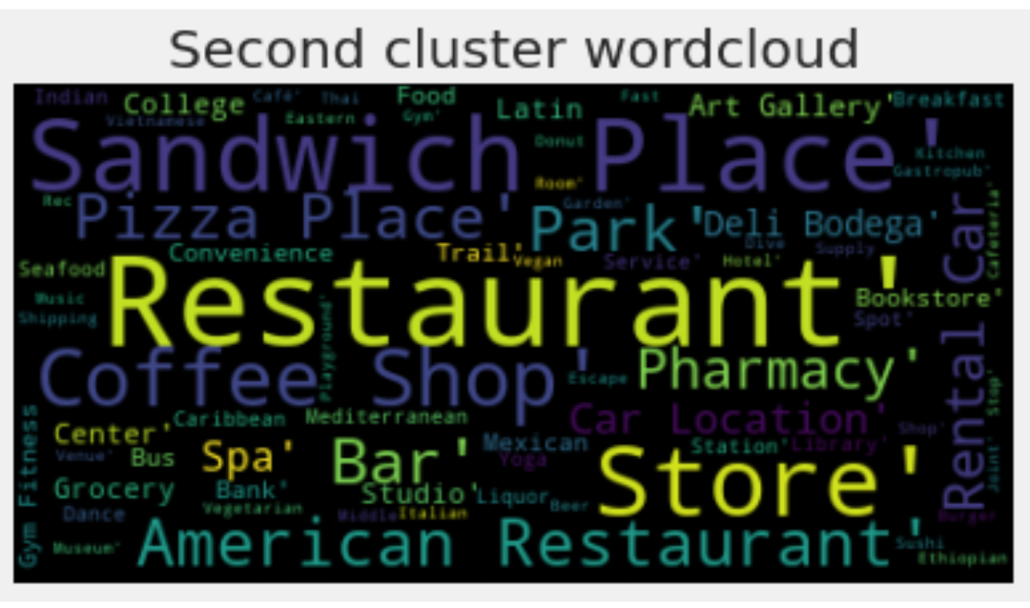
WORDCLOUD REPRESENTATION OF EACH CLUSTER
The first cluster shows that eateries, lodges, and relaxation spots are good business
ventures
The second cluster shows that eateries, shopping centers, relaxation spots and medical facilities could be a good business
Enter title here
Click here to add content of the text，and briefly explain your point of view
Enter title here
Enter title here

Slide 12
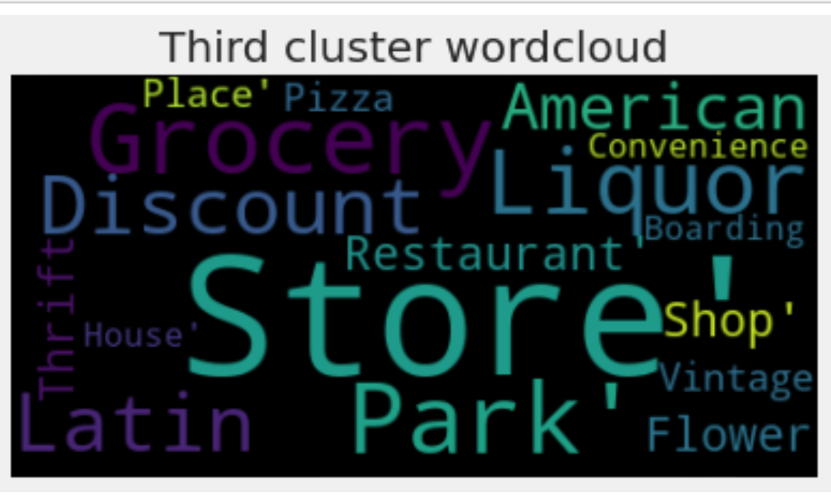
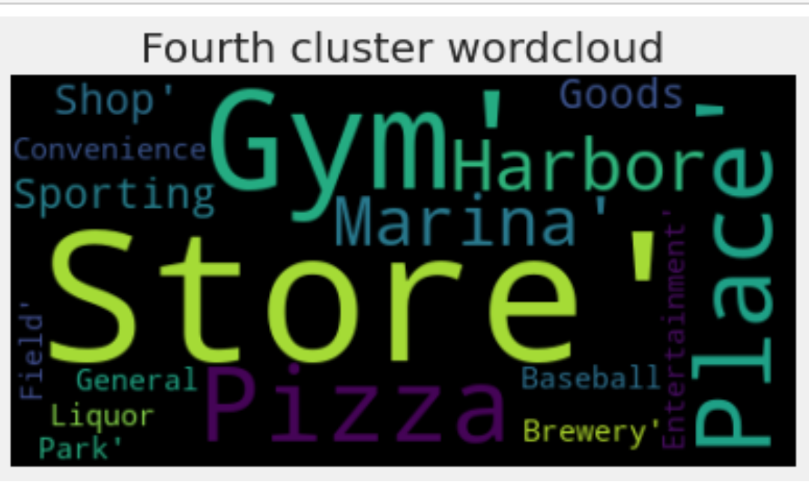
WORDCLOUD REPRESENTATION OF EACH CLUSTER CONTINUED
The fourth cluster shows a shopping center, fitness center, relaxation spots and sporting
facility could be a good business investment
The third cluster shows shopping centers, relaxation spots and convenience facilities could be good business ventures

Slide 13
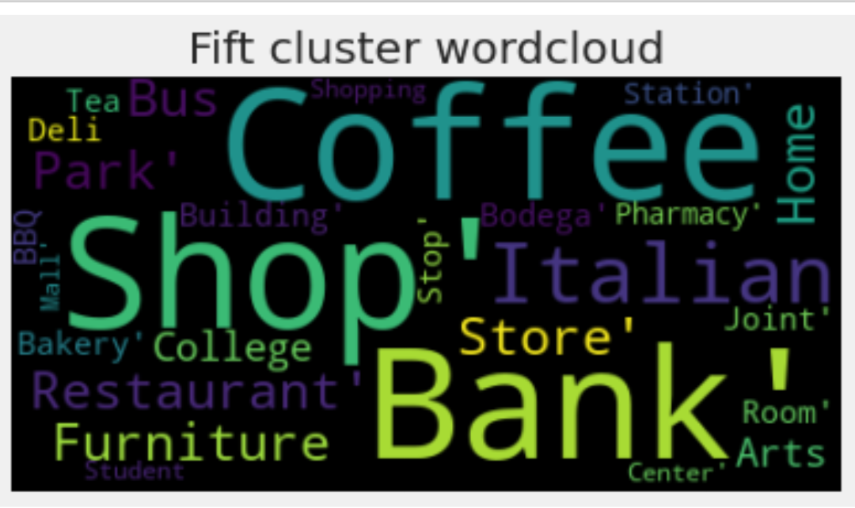
WORDCLOUD REPRESENTATION OF EACH CLUSTER CONTINUED
The fifth cluster shows shopping centers, relaxation spots, financial institutions and
educational facilities could be good businesses

Slide 14
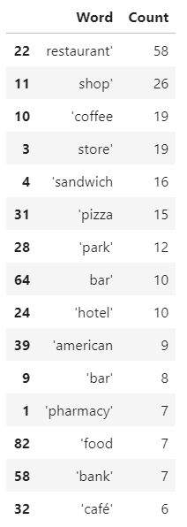
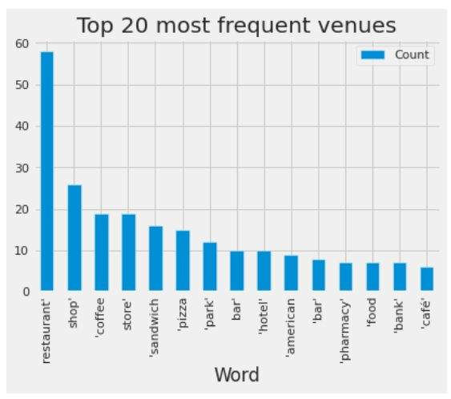
CHECKING THE TOP MOST FREQUENT VENUES IN THE CLUSTER S
48%
46%
42%
31%
25%
12%

Slide 15
DISCUSSION
Some ventures that may not be common but not less lucrative could be financial
institutions (bank), medical facilities (pharmacy) and fitness facilities (gym)
1
Any kind of relaxation spot is a lucrative business around a university campus
4
The campuses are almost over loaded with restaurants which tells us that one is bound
to face huge competitions. so you could decide to go for less competitive business
venture like coffee shop
Coffee shops appear to be an easy and less capital intensive business venture to
invest in.
2
5
3
6
Further analysis could be embarked on to have two words processing so we could have
something like ‘coffee shops’ not just ‘coffee’ to see if one word processing had any
negative effect on the results.
Next to relaxation spots is eateries and shopping centers

Slide 16
CONCLUSION
This work recommends what business venture is most suited for a United States college or
university campus which can easily be repeated across any university campus across any country. It
reiterates the power of analytics in helping business owners understand what business venture to go
into depending on the geographical location. The interesting part is that it does not really have to be
for multinational organisations. It is an easy and simple approach that small to mid-size enterprises
can embrace.

Slide 17
THANK YOU
Reporter: XX

